Slide 1


4G Network Congestion Analysis & Radio Upgrade Strategy
Case Study: Milan Urban Area
PRESENTED BY
Marwa Shaaban Abd Elhakim

Slide 2

The Problem & The Goal
Problem: Increasing customer complaints about slow internet speeds.
Goal: Use data analysis to find the root cause and propose a smart, cost-effective upgrade plan.

Slide 3
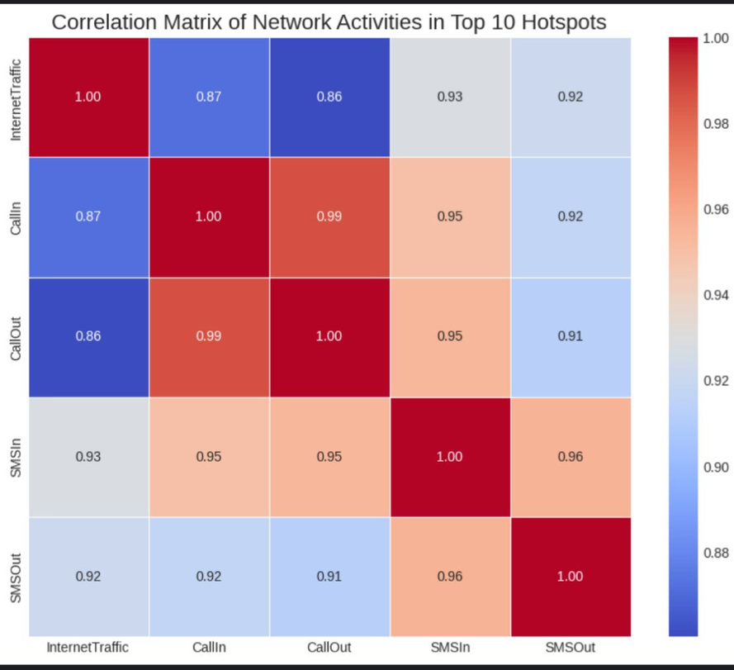
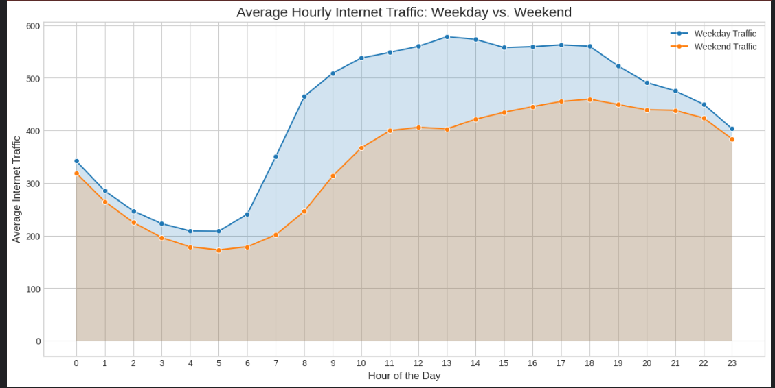
Temporal & Spatial Analysis
Temporal Analysis (When?):
weekdays and weekends.
The overall network busy hour at 17:00 (5 PM).
Spatial Analysis (Where?):
The Top 10 hotspots have been identified,
which are the primary source of customer complaints.

Slide 4
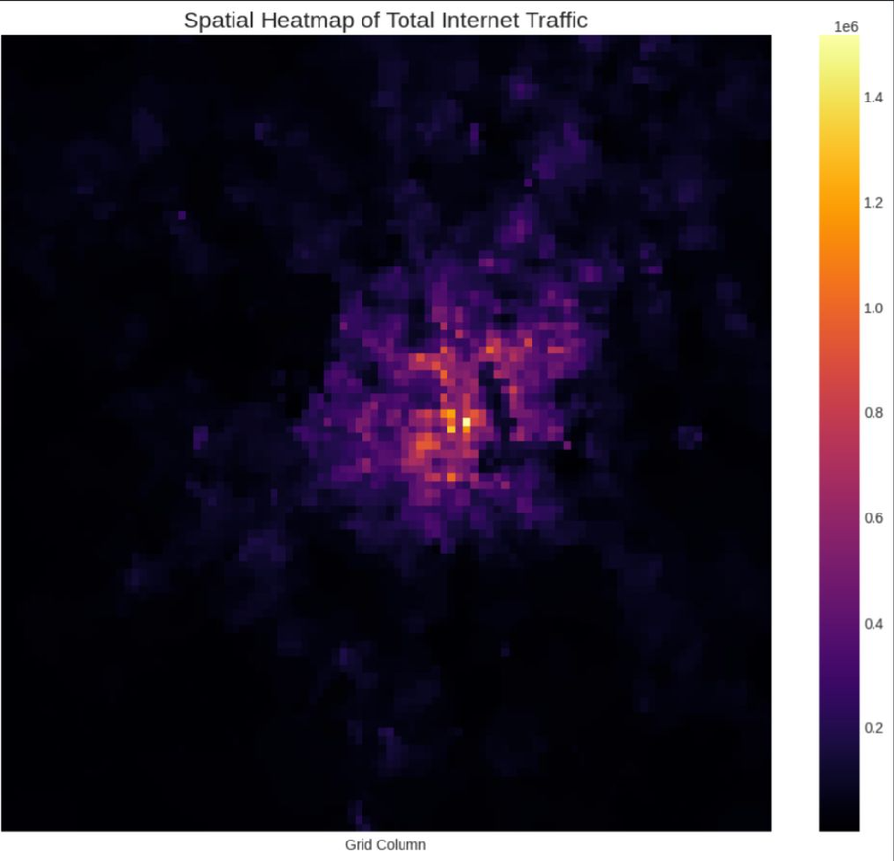
Root Cause Diagnosis
During the busy hour, the top hotspots capacity utilization of 80% to 95.5% of (150 Mbps).

Slide 5
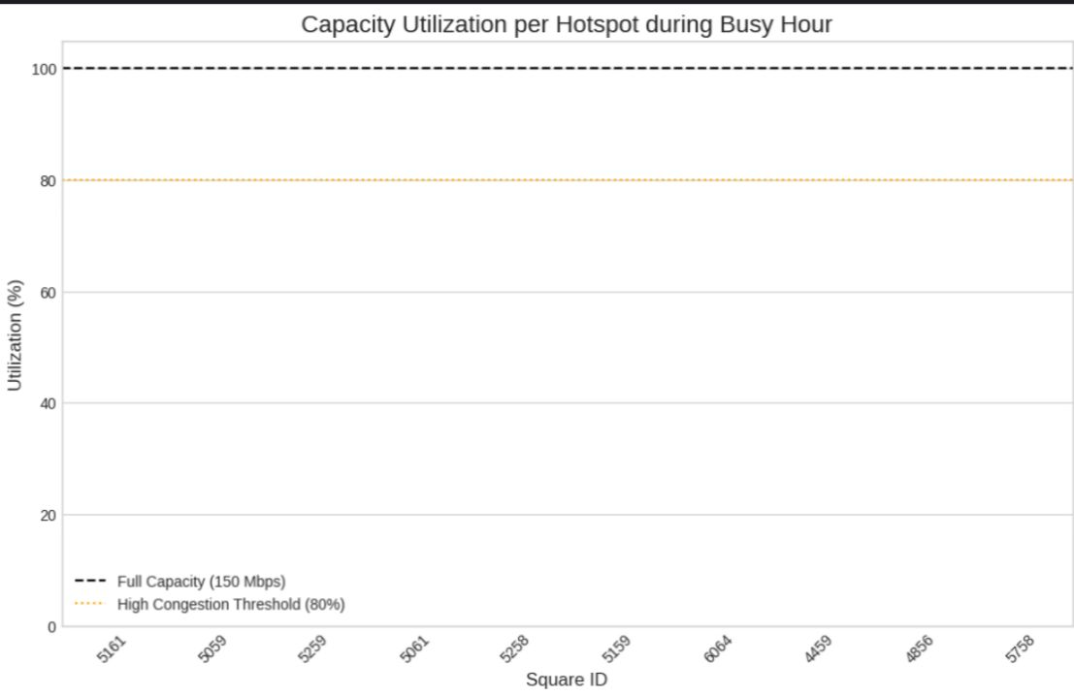
Strategic Upgrade Plan
Phase 1: Quick Wins
• Implement Load Balancing
• Optimize Quality of Service (QoS)
Phase 2: Targeted Upgrades
• Activate Carrier Aggregation (CA)
• Upgrade antennas to 4x4 MIMO
Phase 3: Long-Term Solution
• Implement Sector Splitting

Slide 6

Conclusion
from raw data to a clear diagnosis: a specific capacity problem in defined locations and times.
The proposed plan offers a practical path to improve the customer experience.

Slide 7

Thank You
Questions?

